Slide 1
The changing household structure of tenants in new affordable housing in the English housing association sector, 1990–2011
Housing Studies Association Conference 2012 : How is the Housing System Coping?
19th April 2012, University of York
Connie P.Y. Tang

Slide 2
The research
To clarify the trends in the allocation of new affordable housing in the housing association (HA) sector in England
To provide detailed on which household types are being increasingly allocated in new HA housing
To understand the reasons why particular household types are moving into new built HA houses
Source of data: the COntinuous REcording Lettings and Sales of Social Housing – HA General Needs letting from 1989/90–2010/11

Slide 3
Growth of HA building activity
Source: DCLG Live Table 232.
Private enterprise: over 80% of all completions
HAs: 9% in 1990/91 to 21% in 2010/11

Slide 4
Growth of 2-bed flats in HA new built homes
 | Housing association
 | % of flats | % of 1 bedroom | % of 2 bedrooms | % of 3 bedrooms | % of 4 or more bedrooms
1991/92 | 56 | 39 | 41 | 18 | 2
1992/93 | 46 | 34 | 40 | 23 | 3
1993/94 | 35 | 25 | 45 | 28 | 2
1994/95 | 31 | 21 | 45 | 30 | 4
1995/96 | 29 | 20 | 45 | 31 | 4
1996/97 | 32 | 21 | 44 | 32 | 3
1997/98 | 29 | 19 | 42 | 33 | 6
1998/99 | 29 | 18 | 44 | 33 | 5
1999/00 | 29 | 20 | 44 | 32 | 4
2000/01 | 37 | 19 | 46 | 30 | 5
2001/02 | 36 | 17 | 49 | 28 | 6
2002/03 | 39 | 17 | 45 | 29 | 9
2003/04 | 46 | 14 | 54 | 25 | 7
2004/05 | 53 | 18 | 52 | 24 | 6
2005/06 | 58 | 19 | 56 | 21 | 4
2006/07 | 66 | 24 | 56 | 17 | 3
2007/08 | 66 | 18 | 60 | 18 | 4
2008/09 | 63 | 17 | 61 | 18 | 4
2009/10 | 60 | 18 | 54 | 22 | 6
2010/11 | 50 | 14 | 54 | 26 | 6
Source: DCLG Live Table 254.

Slide 5
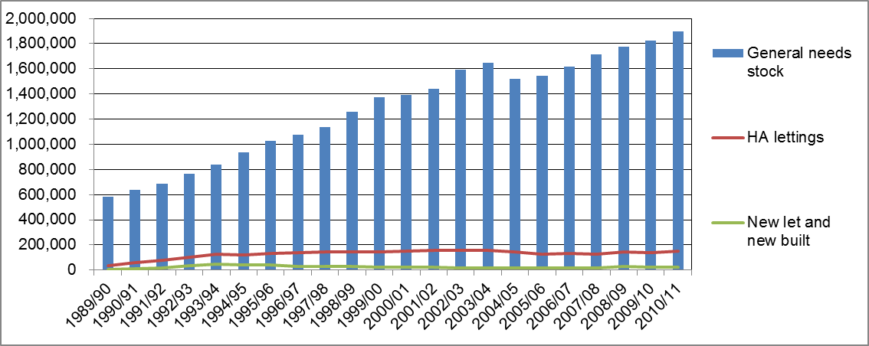
General needs stock, new lets and new built units
Sources: RSR and HA CORE general needs 1989/90–2010/11.
Declining trend of HA turnover from 15% in 1993/94 to 8% in 2005/06–2010/11
New lets and new built in all HA lettings declined since the early 1990s (36% in 1993/94) to 15% since 2005/06
Notes:
The dip of the total no. of GN stock after 2004/05 was because of the reclassification of sheltered housing from General needs to Supported Housing.
The no. of total HA lettings was around 151,000 in 2010/11.
The proportion of new lets has declined since the early 1990s. This suggests that in 1993/94, a new tenant had a higher chance of getting a new home than today because the sector has grown through stock transfers while new build has declined.
In absolute no. terms, the no. of new let & new built increased from 12,045 in 1990/91 to 44,945 in 1993/94 (the highest), then dropped to 19,409 in 2006/07, increased again to 24,950 in 2010/11.

Slide 6
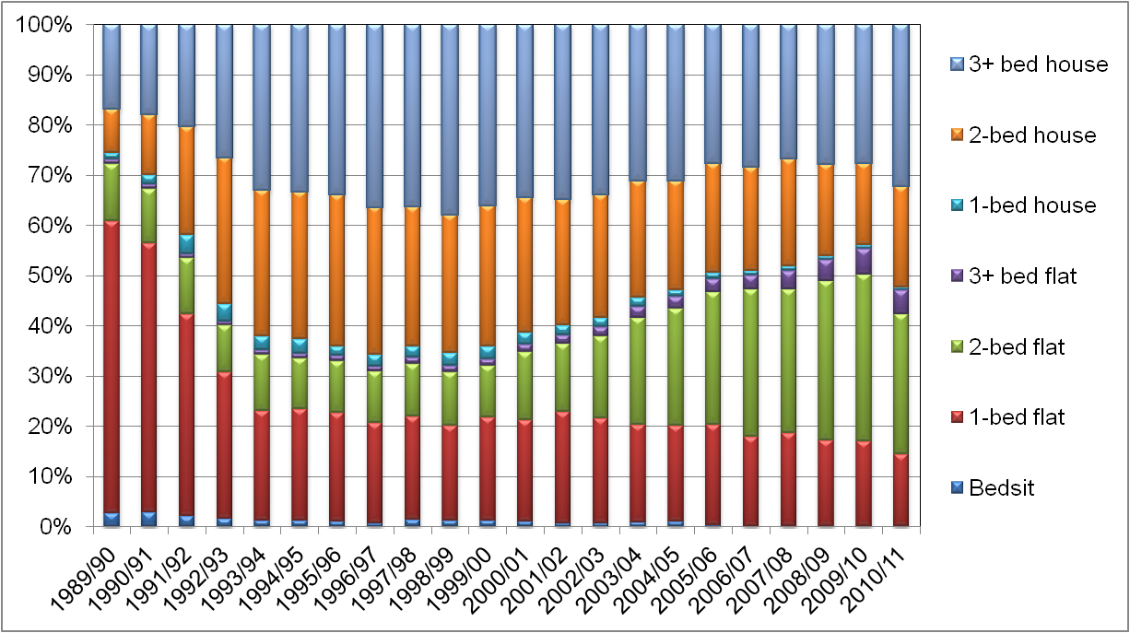
New lets and new built units by bedsize and property type
Source: HA CORE general needs 1989/90–2010/11.
Higher proportion of 3-bed houses: 16% of all new lets and new built in 1989/90, 32% in 2010/11
Increasing proportion in 2-bed flats
Notes:
There was a declining proportion of flats in new lets and new built – from 67% in 1989/90 to 47% in 2010/11. 1-bed flats declined the most while 2-bed flats increased from 11% to 28% in the same period.
An increasing proportion of houses – from 26% in 1989/90 to 53% in 2010/11. The proportion of houses in all new lets and new built were peaked at 68% in 1996/97 and 1998/99.

Slide 7
Policies that influenced HA allocation
The 1996 Housing Act – HAs give priority to unintentionally homeless households, via nomination agreements with local authorities
Housing Green Paper (2000) – promote choice through Choice Based Lettings
Sustainable Communities – create mixed communities
DCLG’s guidance on social housing allocations published in 2009 gave local authorities to prioritise needs specific to their local areas (through local lettings policies, local preference criteria, different ways of determining priorities between people)

Slide 8
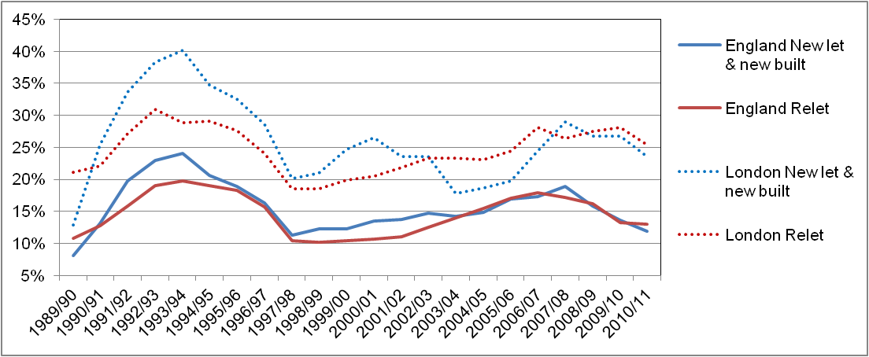
Route to new lets and new built units – previously homelessness
Source: HA CORE general needs 1989/90–2010/11.
England: before 2002/03, proportion of statutory homeless households to new let & new built units > existing units
London: higher proportion of homeless households
Notes:
In England, before 2002/03, the proportions of households in new let & new built units who were statutory homeless were greater than those in existing units (i.e., relets). After then, there was no difference in proportions of households in new let & new built and relets who were previously homeless. In general, the proportion of households who were previously homeless in new let & new built was declined from 24% in 1993/94 to 12% in 2010/11.
London followed the national pattern, but the proportions of homeless households in both types of units were greater. In 2010/11, 24% of households in new let & new built were previously homeless.

Slide 9
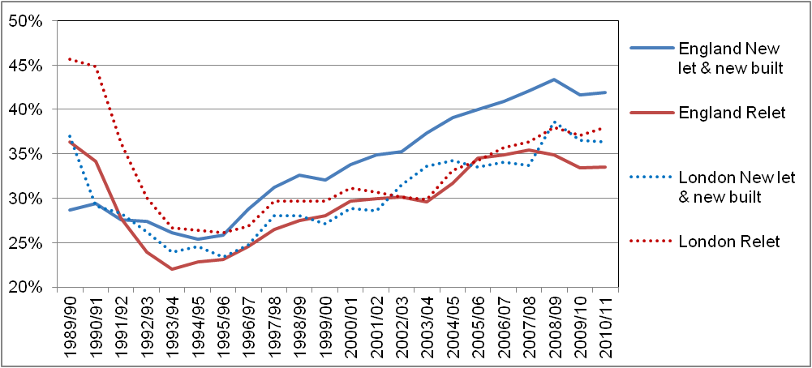
Households in new lets and new built units – economic active
Source: HA CORE general needs 1989/90–2010/11.
England: increasing proportions of economic active households in new let & new built units
London: lower proportions of economic active households
Notes:
Economic active households are households who have at least 1 member is employed (full time or part time), under government training scheme or student.
In England, the proportions of households in new let & new built units who were economic active were greater than those in relets. In fact, the proportions of employed households were increasing from 1994/95 and reached 42% in 2010/11.
Although London followed the national pattern with increasing economic active households in new let & new built units, there was not much difference in proportions of this types of households in both types of units in later years. In 2010/11, 36% of households in new let & new built were economic active, which was lower than the national average. This might because of London having a higher proportion of households who were previously homeless.

Slide 10
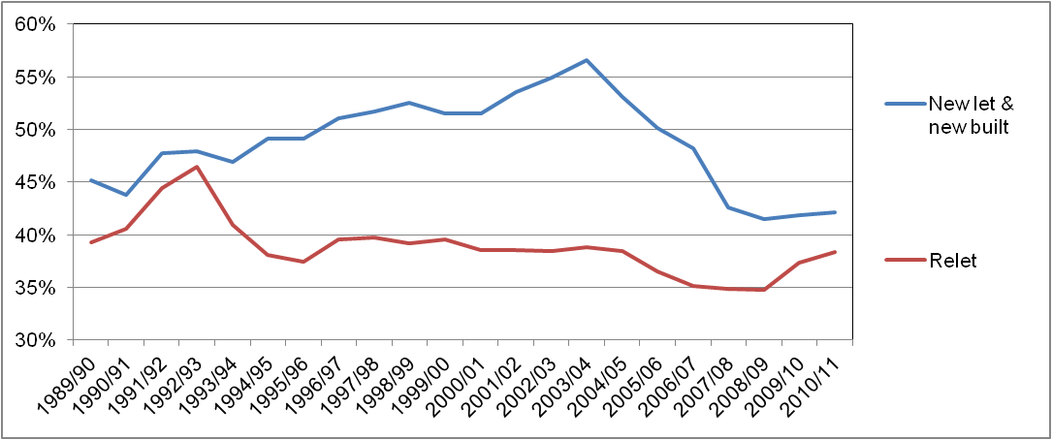
Route to new lets and new built units – previous tenure
Source: HA CORE general needs 1989/90–2010/11.
Proportion of households in new let & new built units who were previously social tenants > existing units
Notes:
The proportions of households in new let & new built units who were previously social tenants (i.e., council or HA tenants) were always greater than those in relets. Such proportion of households increased from 44% in 1990/91 to 57% in 2003/04, then fell to 42 in 2009/10 and 2010/11.

Slide 11
Households in new lets and new built units – household type
 | New let and new built |  |  | Relet
 | 1990/91 | 2000/01 | 2010/11 | 1990/91 | 2000/01 | 2010/11
1 elder | 27% | 9% | 4% | 22% | 17% | 6%
2 elders | 13% | 5% | 4% | 8% | 5% | 3%
1 adult | 20% | 19% | 20% | 29% | 36% | 40%
2 adults | 7% | 5% | 8% | 9% | 6% | 8%
1 adult + 1+ children | 14% | 31% | 31% | 17% | 21% | 23%
2+ adults + 1+ children | 17% | 22% | 26% | 14% | 11% | 15%
Other | 2% | 9% | 7% | 2% | 5% | 4%
 | 100% | 100% | 100% | 100% | 100% | 100%
Source: HA CORE general needs 1990/91–2010/11.
Very high proportions of households in new let & new built units were family with children, in particular single parents
Single adults were the dominant household groups in relets

Slide 12
Summary of findings
Allocation policy | Outcomes
Priority to unintentionally homeless | No difference between new let & new built and relet, except London had higher proportions of homeless households
Create mixed communities | More working households in new let & new built (except London); more families with children in new let & new built
Prioritise local needs and local preference criteria | Households who were previously social tenants were more likely allocated to new let & new built units
But another reason may be
Recall the higher proportion of new let & new built units were houses

Slide 13
What are the next steps?
Need to look at why single parents were more likely to be allocated in new let & new built units – were they via homeless route, or working, etc.
Are there any regional difference, in particular between London and rest of England
Wait until August when 2011/12 CORE and RSR to see how localism agenda and Affordable Rent regime affects the allocation of which household go to new let and new built units
Any suggestion on further study is welcomed

Slide 14
Connie P.Y. Tang
Department of Land Economy
pyt20@cam.ac.uk

